Slide 1
Eren Keskin

Slide 2
Founder of the legal aid for victims of sexual abuse and violence in Turkey.

Slide 3
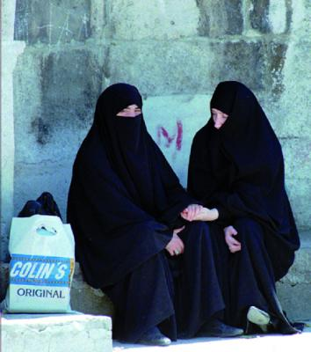
The condition of the woman and their rights in Turkey are constantly called into question. Their struggle began in 1857 when it was introduced into the principle of equality between men and women.

Slide 4
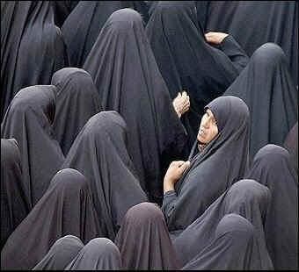
The Turkish woman must emancipate or otherwise choose to stay in shade so as not to suffer. Despite the progress made, Turkey still as much work to do to ensure women’s rights.

Slide 5
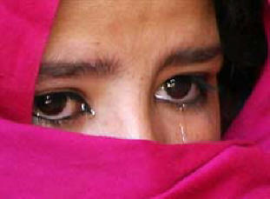
The institutions still find that violence against women is a problem and in fact identified the need to encourage judges to apply a new law to severely punish violence in general and, as previously stated, crimes of honor, forced marriages and more particularly polygamy.

Slide 6
Members of the Parliament complain that in parts of south-eastern Turkey girl are not registered at birth, which prevents combat forced marriage and crimes of honor.

Slide 7
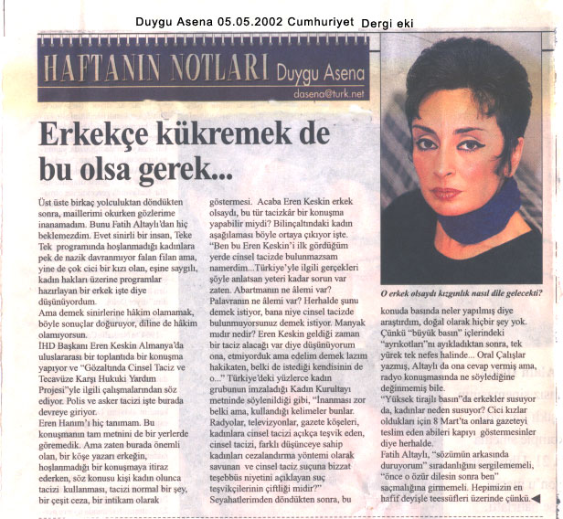

Slide 8
For this speech she was accused by the Commander of the army Necla Arat of “insulting the moral character of the military”. Against her was open a process by the Military Court of the third district of Kartal. In 2006 she was sentenced to 10 months in prison. Later, however, the court changed the sentence to a fine of about 3.666 euro. But her said to refuse buy her freedom because her imprisonment was a real violation of her freedom of expression.

Slide 9
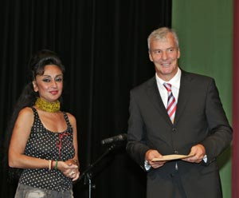
Eren Keskin promulgated a speech in 2002 in Colonie in Germany, for a conference entitled Women’s rights are human rights.

Slide 10
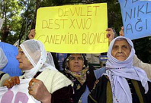
Recently the country was set up advisory commitee on the status of women in Parliament which requires equal treatment of all nongovernmental organizations (ONG), that is also the women free and autonomous, and urges more structured cooperation and more effective coordination between the ministry and ONG.

Slide 11
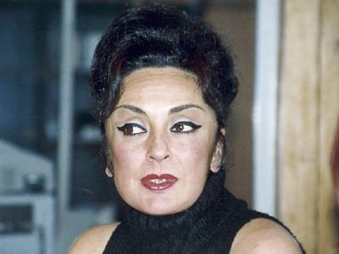
Eren Keskin is one of the many women who have struggled to develop a culture of human rights and democracy in Turkey. Throughout her career, thanks to the Legal Aid Office, she has helped 222 women who have suffered sexual violence.

Slide 12
Created by
Valeria Baccara
Milena Callegaro
Eleonora Callegari
Paola Siviero

