Slide 1
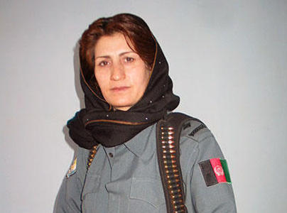
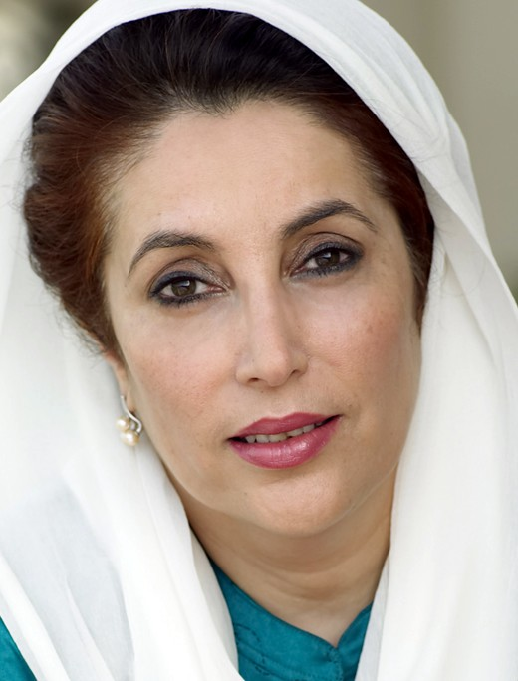
MALALAI KAKAR
&
BENAZIR BHUTTO

Slide 2
Malalai Kakar was a symbol and a promise of Afghan women.

Slide 3
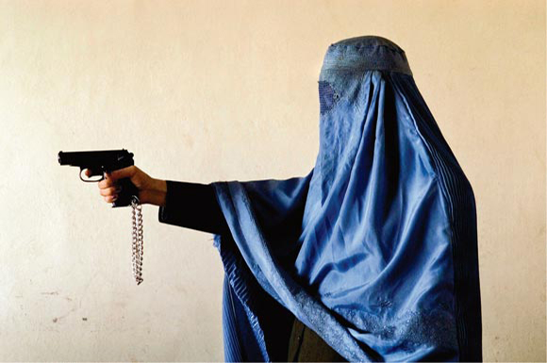
Malalai Kakar was the most high-profile policewoman in Afghanistan.
She received
numerous death
threats and was
assassinated by
the Talibans.

Slide 4
Kakar was called by Masuda Sultan
“A DYNAMO"
“Beat you to change things, to show that it is possible to follow even for Afghan women the path of democracy and liberty!”

Slide 5
“I enrolled in the police because my father sent me a love for his work”.
“Things I do not
men ever do!”
“This is the last
day that we can,
this is the last day
that I greet my six
children”.

Slide 6
Sunday 28 September 2008 she was murdered in Kandahar.

Slide 7
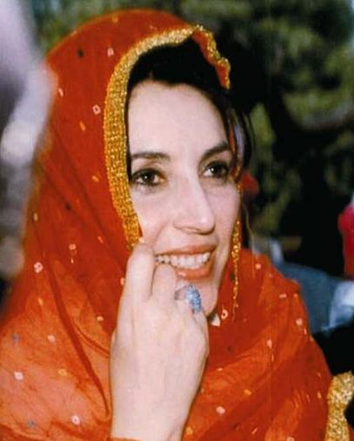
Benazir Bhutto has done much to restore democracy in Pakistan.
She was a courageous woman who was beaten and continued to fight for the future of her country.

Slide 8
“We must not let the terrorists kill with their bombs, the dream of a democratic Pakistan. They can kill people, but not their ideas that survive on terror”.

Slide 9
At only 39 years Bhutto was appointed head of a coalition government, becoming the youngest person, but also the first woman to hold this position in a Muslim country.

Slide 10
Her dream of a future redemption for her, for all women of Islam and for her homeland ended in blood, and a great void in those who hope in her ability to mediate between Islam and the West has reopened.

Slide 11
December 27, 2007: a suicide bomber kills former Pakistan premier Benazir Bhutto.

Slide 12
In conclusion we hope that soon everyone in Afghanistan to return to fly kites, but especially that women are able to walk with heads held high and determination in the name of freedom!

Slide 13
Created by
Alice Milan
Elena Rubinato
Vania Vettorello
Chiara Vicentini
Nicole Zanellato

